Slide 1

Costavisor – Less Quantity, More Connection

Slide 2

01
Boutique and sustainable tourism based in Nerja & Frigiliana.
02
A limited and carefully curated selection of accommodations for all types of travelers.
Vision and Philosophy – Costavisor
03
Authentic experiences with local certified guides.
04
Professional property maintenance services that build trust with owners.
05
A human, transparent, and warm approach in every interaction.

Slide 3
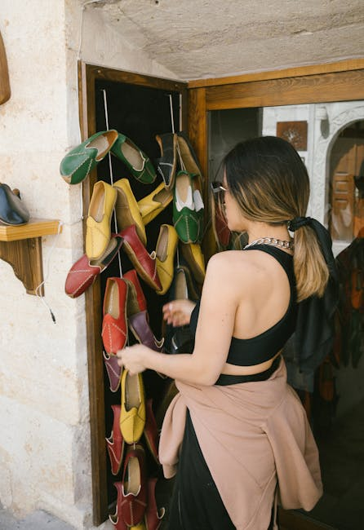
Costavisor’s Value Proposition
For Travelers
Unique stays in carefully selected accommodations, combined with authentic experiences led by local guides, offering a deep connection with the culture and nature of Costa del Sol.
For Property Owners
Comprehensive management including professional maintenance, transparency, and ongoing communication — generating trust and peace of mind.
For the Local Community
Promotion of responsible and sustainable tourism that supports the local economy and preserves cultural heritage.

Slide 4
Costavisor combines three strategic pillars: selective accommodation management, personalized experiences with local guides, and trusted maintenance services for property owners. The model prioritizes quality over quantity, creating genuine connections and sustainable tourism.
Business Model – 'Less Quantity, More Connection'
A Boutique Approach

Slide 5
Costavisor Ecosystem Flow

Slide 6
Positioning Strategy
Boutique Tourism with Purpose
Trust-Based Management
Local and Sustainable Brand
Costavisor promotes experiential and human-centered tourism focused on quality and environmental respect.
Strong and transparent relationships with property owners through professional maintenance and constant care.
Commitment to the culture, economy, and communities of Costa del Sol.

Slide 7
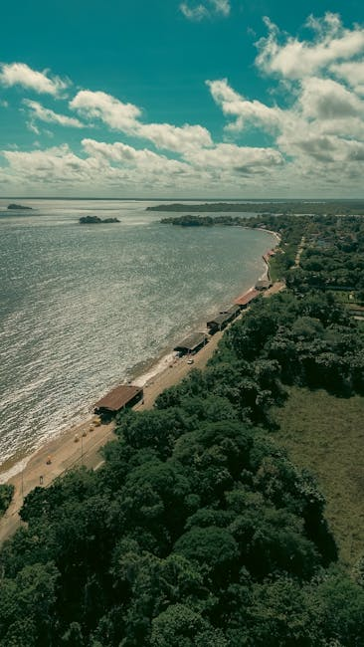
• Manage a maximum of 20 boutique accommodations carefully selected.
• Develop a network of up to 10 certified local guides.
• Maintain a 95% satisfaction rate among travelers and property owners.
• Establish Costavisor as a leading boutique sustainable tourism brand in Costa del Sol.
Strategic Objectives 2025–2026
Quality, Balance, and Sustainable Growth

Slide 8

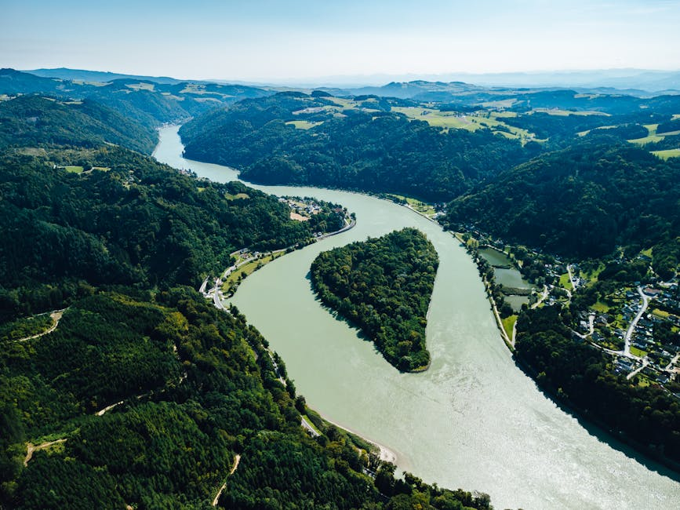
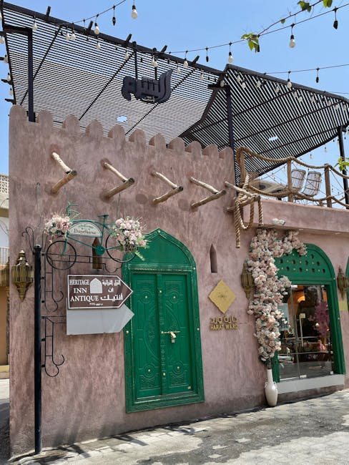
Circular Ecosystem – Costavisor
Visual diagram representing the connection between the six pillars of Costavisor’s business model: Travelers, Property Owners, Local Guides, Local Restaurants, Local Community, and Human Connection & Quality. This ecosystem embodies the brand philosophy: 'Less quantity, more connection.'

Slide 9
Emotional Closing
What makes us unique?
Final Message – Costavisor
At Costavisor, we believe that true value lies not in numbers but in meaningful connections. Every traveler, every property, and every experience is part of a shared story built on trust, authenticity, and care. Our promise is simple yet profound: less quantity, more connection.

